Slide 1
SELECTION OF VIEWS TO MATERIALIZE
Prof. Navneet Goyal
Department of Computer Science & Information Systems
BITS, Pilani

Slide 2

The material in this presentation has been taken from the following survey paper on view selection methods:
“A survey on View Selection Methods” by
SIGMOD Record March, 2012 (vol. 41, no. 1)

Slide 3
View Selection Problem
For a given set of queries and a space constraint, find the optimal set of views to materialize such that the benefit is maximized

Slide 4
View Selection Problem
Objectives:
  Minimize query processing cost
  Minimize view maintenance cost and
  Minimize space requirement
  NP-complete problem!!

Slide 5

Cost Model
Weighted query processing cost:
where fQi is the query frequency of the query Qi
and Qc(Qi,M) is the processing cost corresponding
to Qi given a set of materialized views M.

Slide 6

Cost Model
View Maintenance cost:
where fu(Vi) is the update frequency of the view Vi
and Mc(Vi,M) is the maintenance cost of Vi given
a set of materialized views M.

Slide 7
Static vs. Dynamic View Selection
Static view selection approach is based on a given workload
In a dynamic view selection approach, the view selection is applied as a query arrives
  The workload is built incrementally and changes over time
Because the view selection has to be in synchronization with the workload, any change to the workload should be reflected to the view selection as well.
In the dynamic set up, the portfolio of materialized views can be changed over time and replaced with more beneficial views in case of changing the query workload

Slide 8
Static vs. Dynamic View Selection
We can start with a static approach and when the average query cost goes above a threshold, we change the set of materialized views
  By doing view selection all over again
  Incrementally (preferred)
A dynamic view selection is often referred to as “view caching”

Slide 9
View Selection
Two main steps:
Identifies the candidate views which are promising for materialization. Techniques used:
    Multiquery DAG,
    Query rewriting
    Syntactical analysis of the workload
The second step selects the set of views to materialize under the resource constraints and by applying heuristic algorithms

Slide 10
Multiquery DAG
Detecting common sub-expressions between the different queries and capturing the dependencies among them
The dependence relation on queries (or views) has been represented by using a directed acyclic graph also called a DAG
Most commonly used DAG in literature is the AND/OR view graph

Slide 11
Multiquery DAG
The union of all possible execution plans of each query forms an AND/OR view graph [1/40].
The AND-OR view graph described by Roy [2/42] is a DAG composed of two types of nodes: Operation nodes and Equivalence nodes
Each operation node represents an algebraic expression (SPJ) with possible aggregate function.
An equivalence node represents a set of logical expressions that are equivalent (i.e., that yield the same result).
The operation nodes have only equivalence nodes as children and equivalence nodes have only operation nodes as children.
The root nodes are the query results and the leaf nodes represent the base relations.

Slide 12
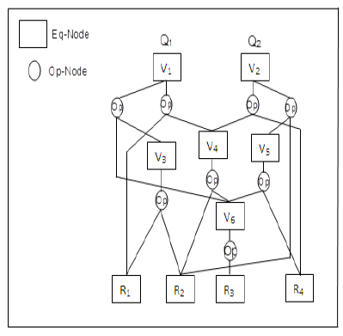
Multiquery DAG
Example AND/OR View Graph
View V1 corresponding to a single query Q1, can be computed from V6 and V3 or R1 and V4
If there is only one way to answer or update a given query, the graph becomes an AND view graph

Slide 13
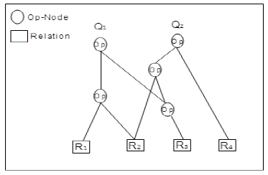
Multiquery DAG
Multi-View Processing Plan (MVPP)
MVPP defined by Yang et al [3] is a directed acyclic graph in which the root nodes are the queries, the leaf nodes are the base relations and all other intermediate nodes are SPJ or aggregation views that contribute to the construction of a given query

Slide 14
Multiquery DAG
The MVPP is obtained after merging into a single plan either individual optimal query plans (similar to the AND view graph) or all possible plans for each query (similar to AND-OR view graph)
The difference between the MVPP representation and the AND-OR view graph or the AND view graph representation is that all intermediate nodes in the MVPP represent operation nodes.

Slide 15
Query Rewriting
Query rewriting based approaches not only compute the set of materialized views but also find a complete rewriting of the queries over it.
Input to view selection is not a multiquery DAG but the query definitions.
The view selection problem is modeled as a state search problem using a set of transformation rules. These rules detect and exploit common subexpressions between the queries of the workload and guarantee that all the queries can be answered using exclusively the materialized views.
The completeness of the transformation rules may make the complexity of state space search strategies exponential.

Slide 16
Syntactical Analysis of Queries
The query workload is analyzed and a subset of relations is picked from which one or more views are materialized, if only it has the potential to reduce the cost of the workload significantly.
However, the search space for computing the optimal set of views to be materialized may be very large.

Slide 17
Resource Constraints
Three main models in literature:
  Unbounded
  Space constrained
  Maintenance cost constrained

Slide 18

Unbounded
There is no limit on available resources (storage, computation etc.)
View selection problem thus reduces to minimization of query cost and view maintenance cost
Two major problems with this approach:
  Selected views may be too large to fit into available space
  The view maintenance cost may offset the performance advantage provided by materialized views

Slide 19
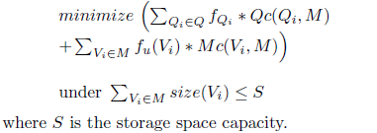
Space Constrained
The space constrained model minimizes the query processing cost plus the view maintenance cost under a space constraint:

Slide 20
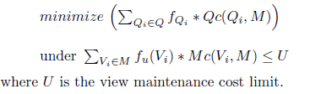
Maintenance Cost Constrained
This model constrains the time that can be allotted to keep up to date the materialized views in response to updates on base relations.
The maintenance cost constrained model minimizes the query processing cost under a maintenance cost constraint

Slide 21
Algorithms for View Selection
Four types of heuristic algorithms have been proposed in literature for view selection:
  Deterministic Algorithms [4/41, 5/37 – A* Algorithm]
  Randomized Algorithms [6/14 – Genetic, 7/30 – Simulated Annealing]
  Hybrid Algorithms [8/56]
  Constraint Programming [9/49, 10/35]

Slide 22
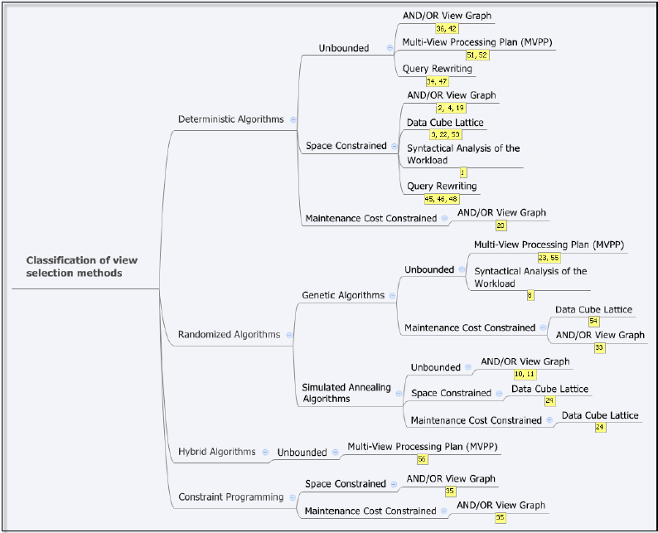
Classification of View Selection Methods

Slide 23
Some Important References
N. Roussopoulos. The logical access path schema of a database. IEEE Trans. Software Eng., 8(6):563–573,1982.
P. Roy, S. Seshadri, S. Sudarshan, and S. Bhobe. Efficient and extensible algorithms for multi query optimization. In SIGMOD Conference, pages 249–260, 2000.
J. Yang, K. Karlapalem, and Q. Li. A framework for designing materialized views in data warehousing environment. In ICDCS, 1997
N. Roussopoulos. View indexing in relational databases. ACM Trans. Database Syst., 7(2):258–290, 1982.
N.J. Nilsson. Problem-Solving Methods in Artificial Intelligence. McGraw-Hill Pub. Co., 1971.
D.E. Goldberg. Genetic Algorithms in Search Optimization and Machine Learning. Addison-Wesley, 1989.

Slide 24
Some Important References
P.J.M. Laarhoven and E.H.L. Aarts, editors. Simulated annealing: theory and applications. Kluwer Academic Publishers, Norwell, MA, USA, 1987.
C. Zhang, X. Yao, and J. Yang. An evolutionary approach to materialized views selection in a data warehouse environment. IEEE Transactions on Systems, Man, and Cybernetics, Part C, 31(3):282–294, 2001.
M. Wallace. Practical applications of constraint programming. Constraints, 1:139–168, 1996. 10.1007/BF00143881.
I. Mami, R. Coletta, and Z. Bellahsene. Modeling view selection as a constraint satisfaction problem. In DEXA, pages 396–410, 2011.

